Slide 1





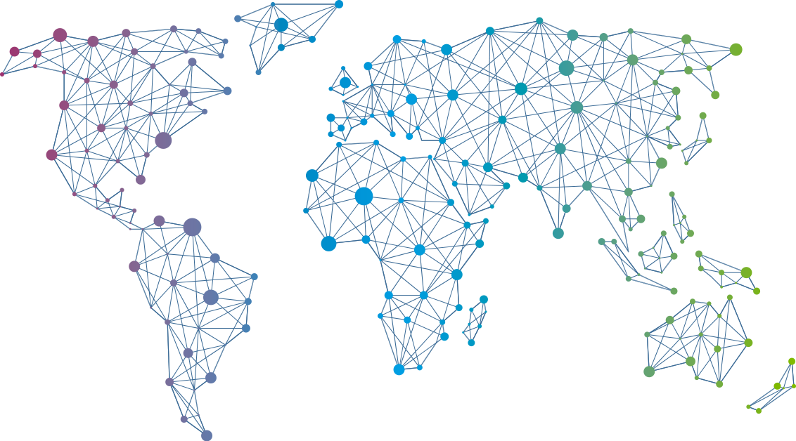

Speaker
Jeff Wouters
Your own (advanced) PowerShell function template in 45 minutes
Jeff Wouters
jeffwouters
September 16th & 17th
^{Online Event}
Powered By
International Conference

